Slide 1

Product Introduction
JH-DW5(Series)

Slide 2
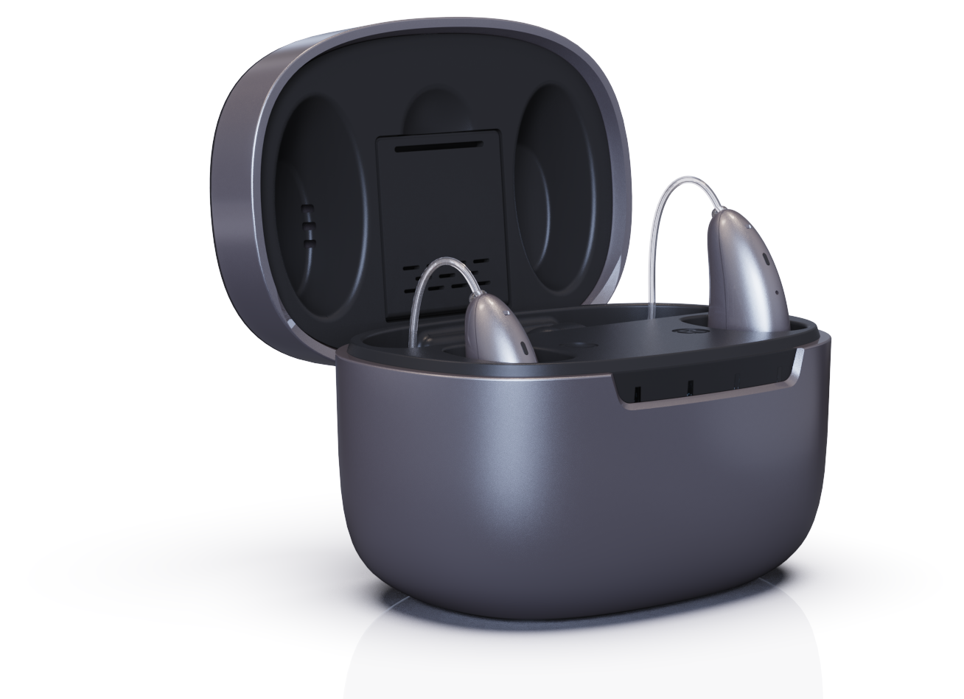

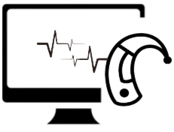




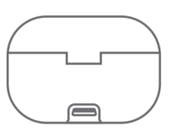

JH-DW5 Series
To Discover Unexpected Life
Enjoy what’s precious, the special time, the beautiful of the voices
APP Control | Wireless Programme | Direct Audio Streaming
DSP | 4 Hearing Mode | UV Sterilization | Recharging on-the-go

Slide 3
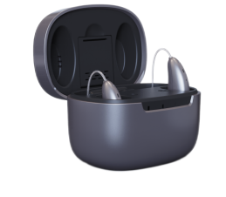
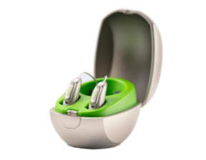
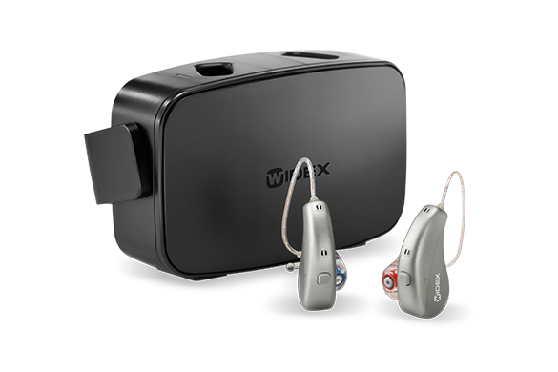
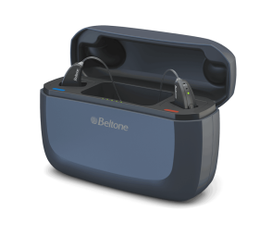
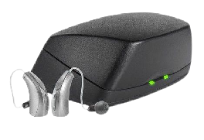
COMPETITORS COMPARISON
Brand/Model | JH-DW5B | Phonak - Paradise | Widex - Moment | Beltone - Amaze | Starkey - Livio
Photo
Types | RIC/RITE | RIC/RITE | RIC/RITE | RIC/RITE | RIC/RITE
Power Type | Built-in Rechargeable | Built-in Rechargeable | Built-in Rechargeable | Built-in Rechargeable | Built-in Rechargeable
Battery type | Lithium | Lithium | Lithium | Lithium | Lithium
Chargingcase | ✔ | ✔ | ✔ | ✔ | ✔
Volume adjustment | Push button/APP | Push button/APP | Push button/APP | Push button/APP | Push button/APP
Hearing Aid Fully Charge time | ≤2h | ≤3h | ≤4h | ≤3h | ≤3h
Hearing Aid Working time | 24h | 16h | 16-20h | 30h | 24h
Power on and off | Push button/Back to case | Push button/Back to case | Push button/Back to case | Push button/Back to case | Push button/Back to case
Charging indicator light | ✔(on Charging Case) | ✔(on Charging Case) | ✔(on Charging Case) | ✔(on Charging Case) | ✔(on Charging Case)
Advantages of JH compare to competitors

Slide 4
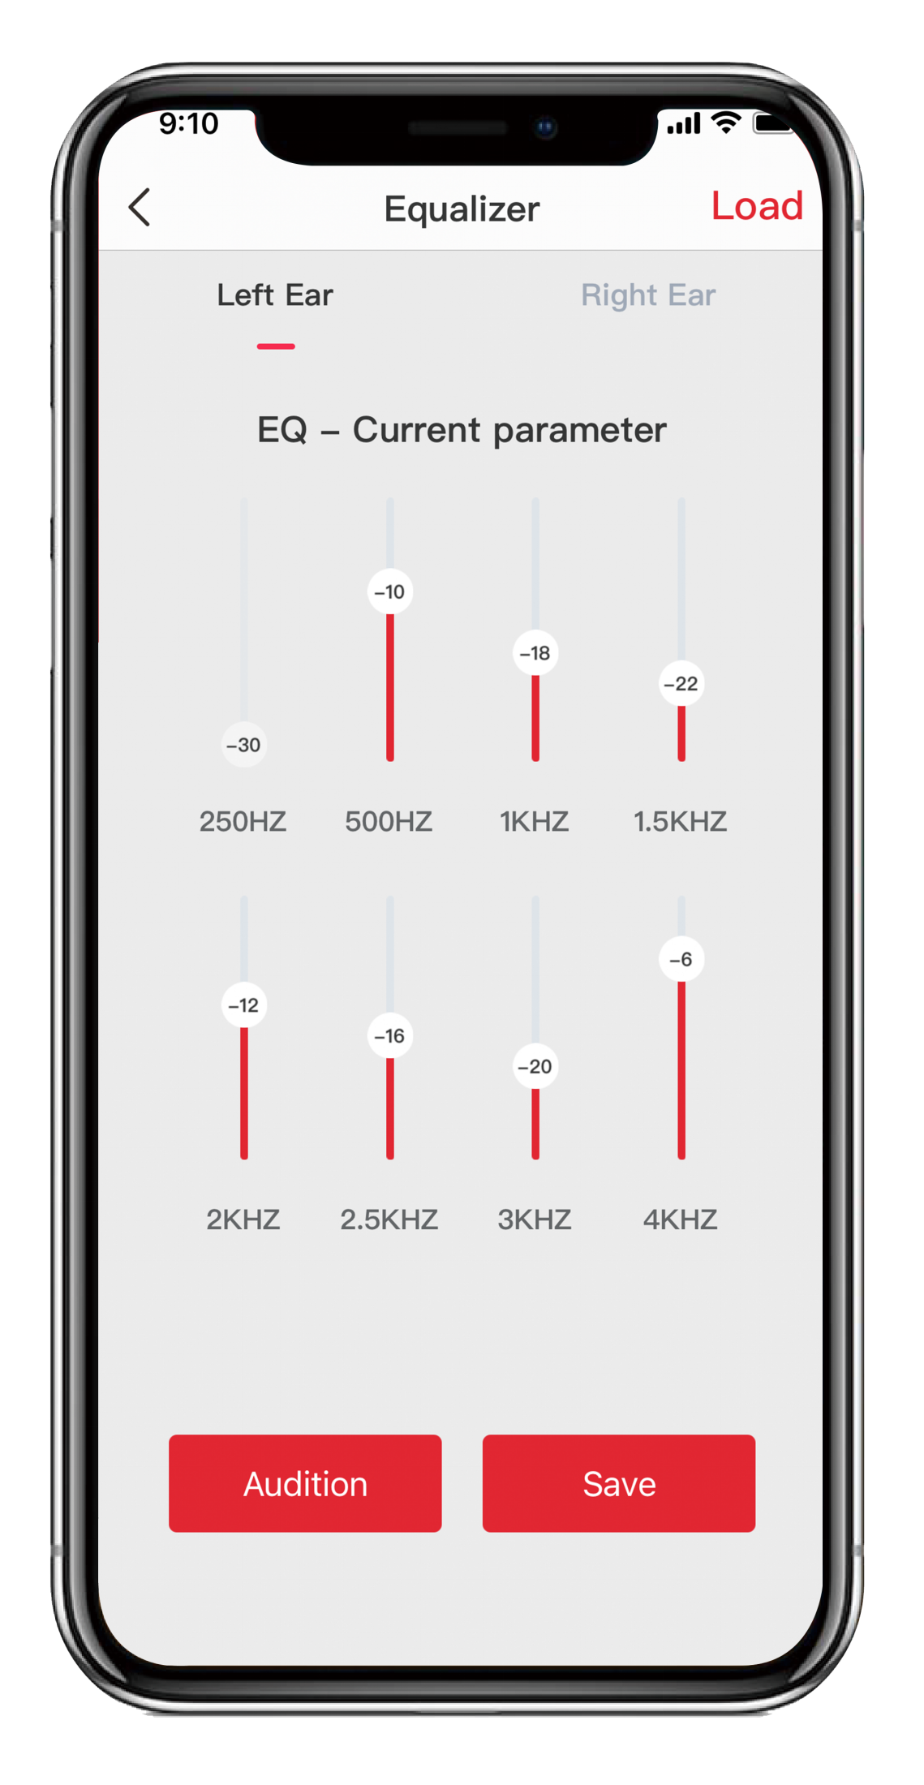

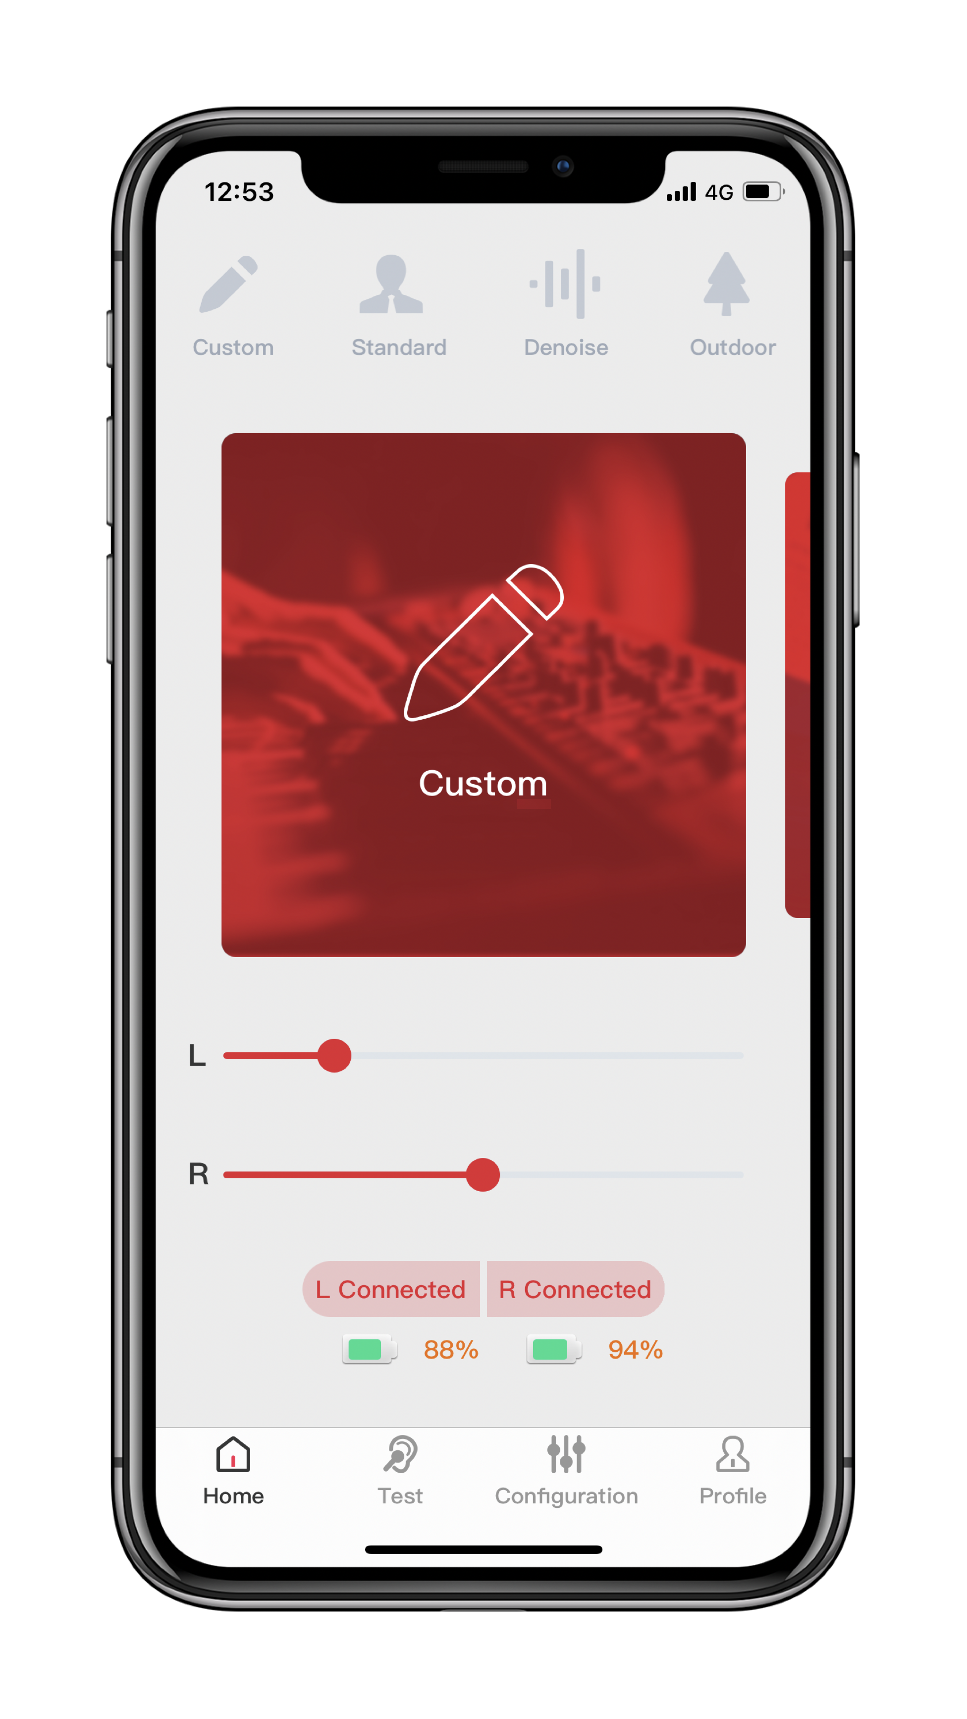
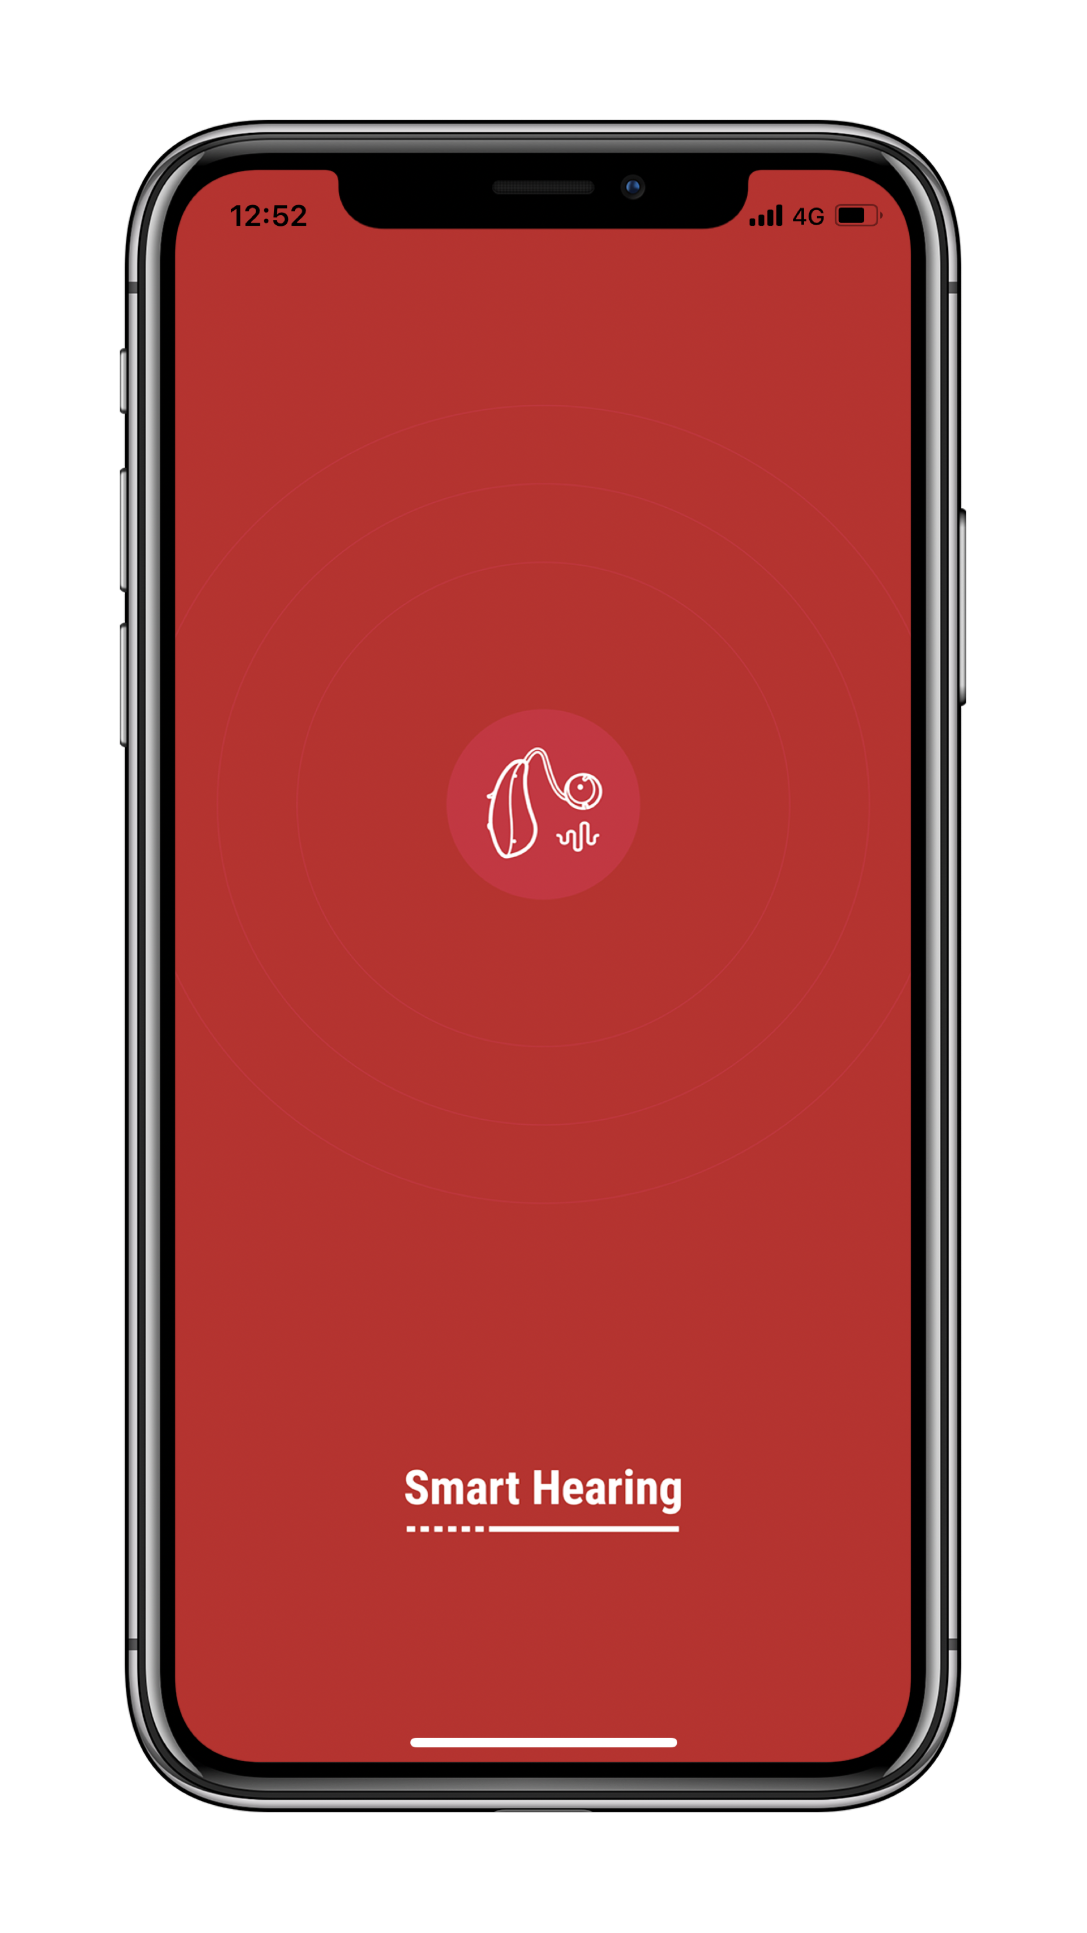

Hearing Control
*Android phones | iPhone | iPad | iPod

Slide 5



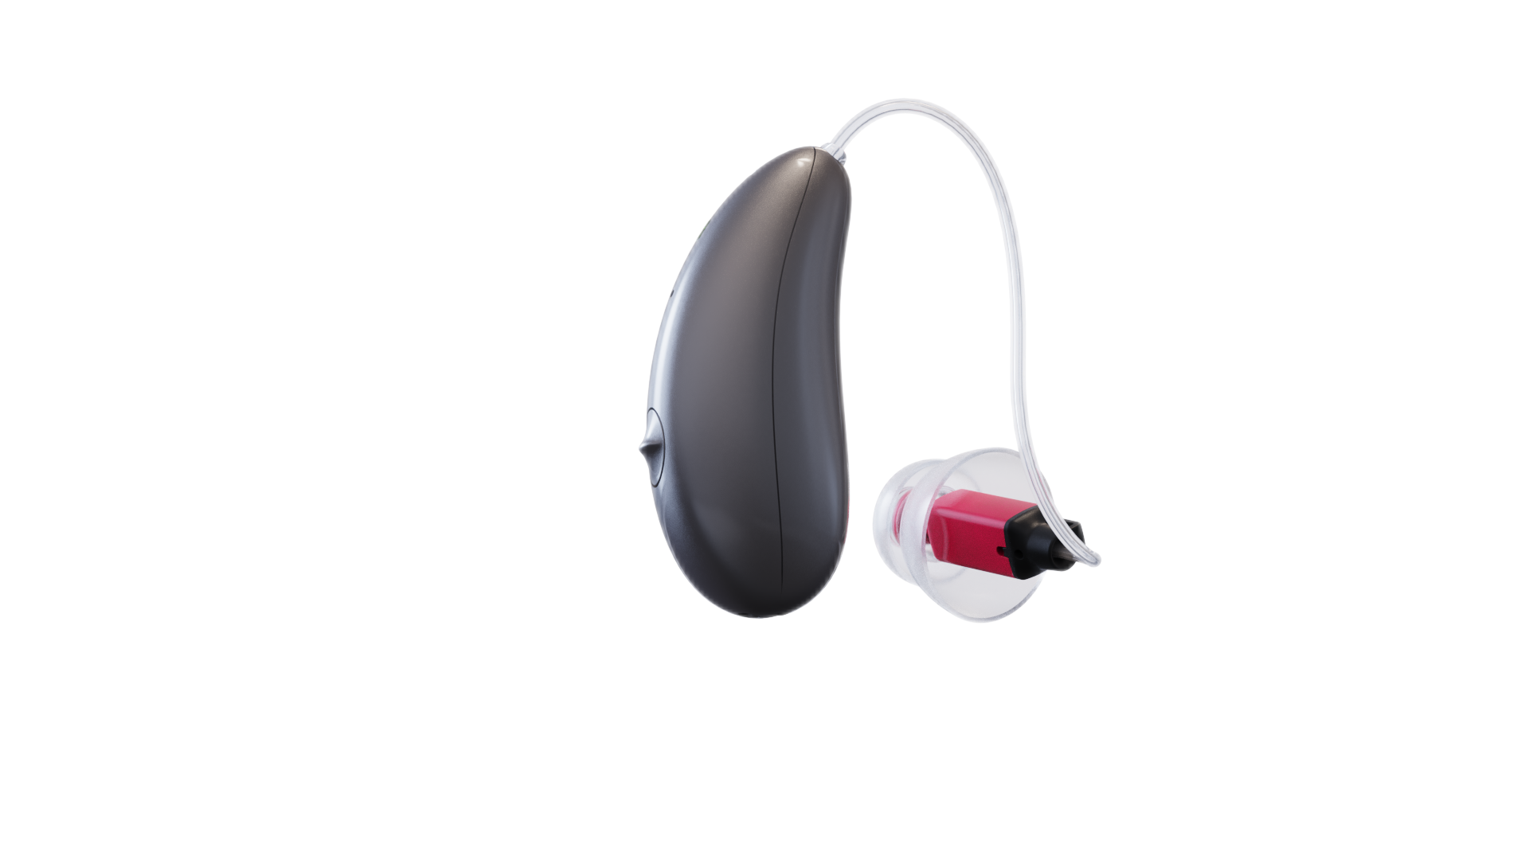


Wireless Programme
HearLUX Wireless Fitting Software©
No need to worry about programming lines

Slide 6
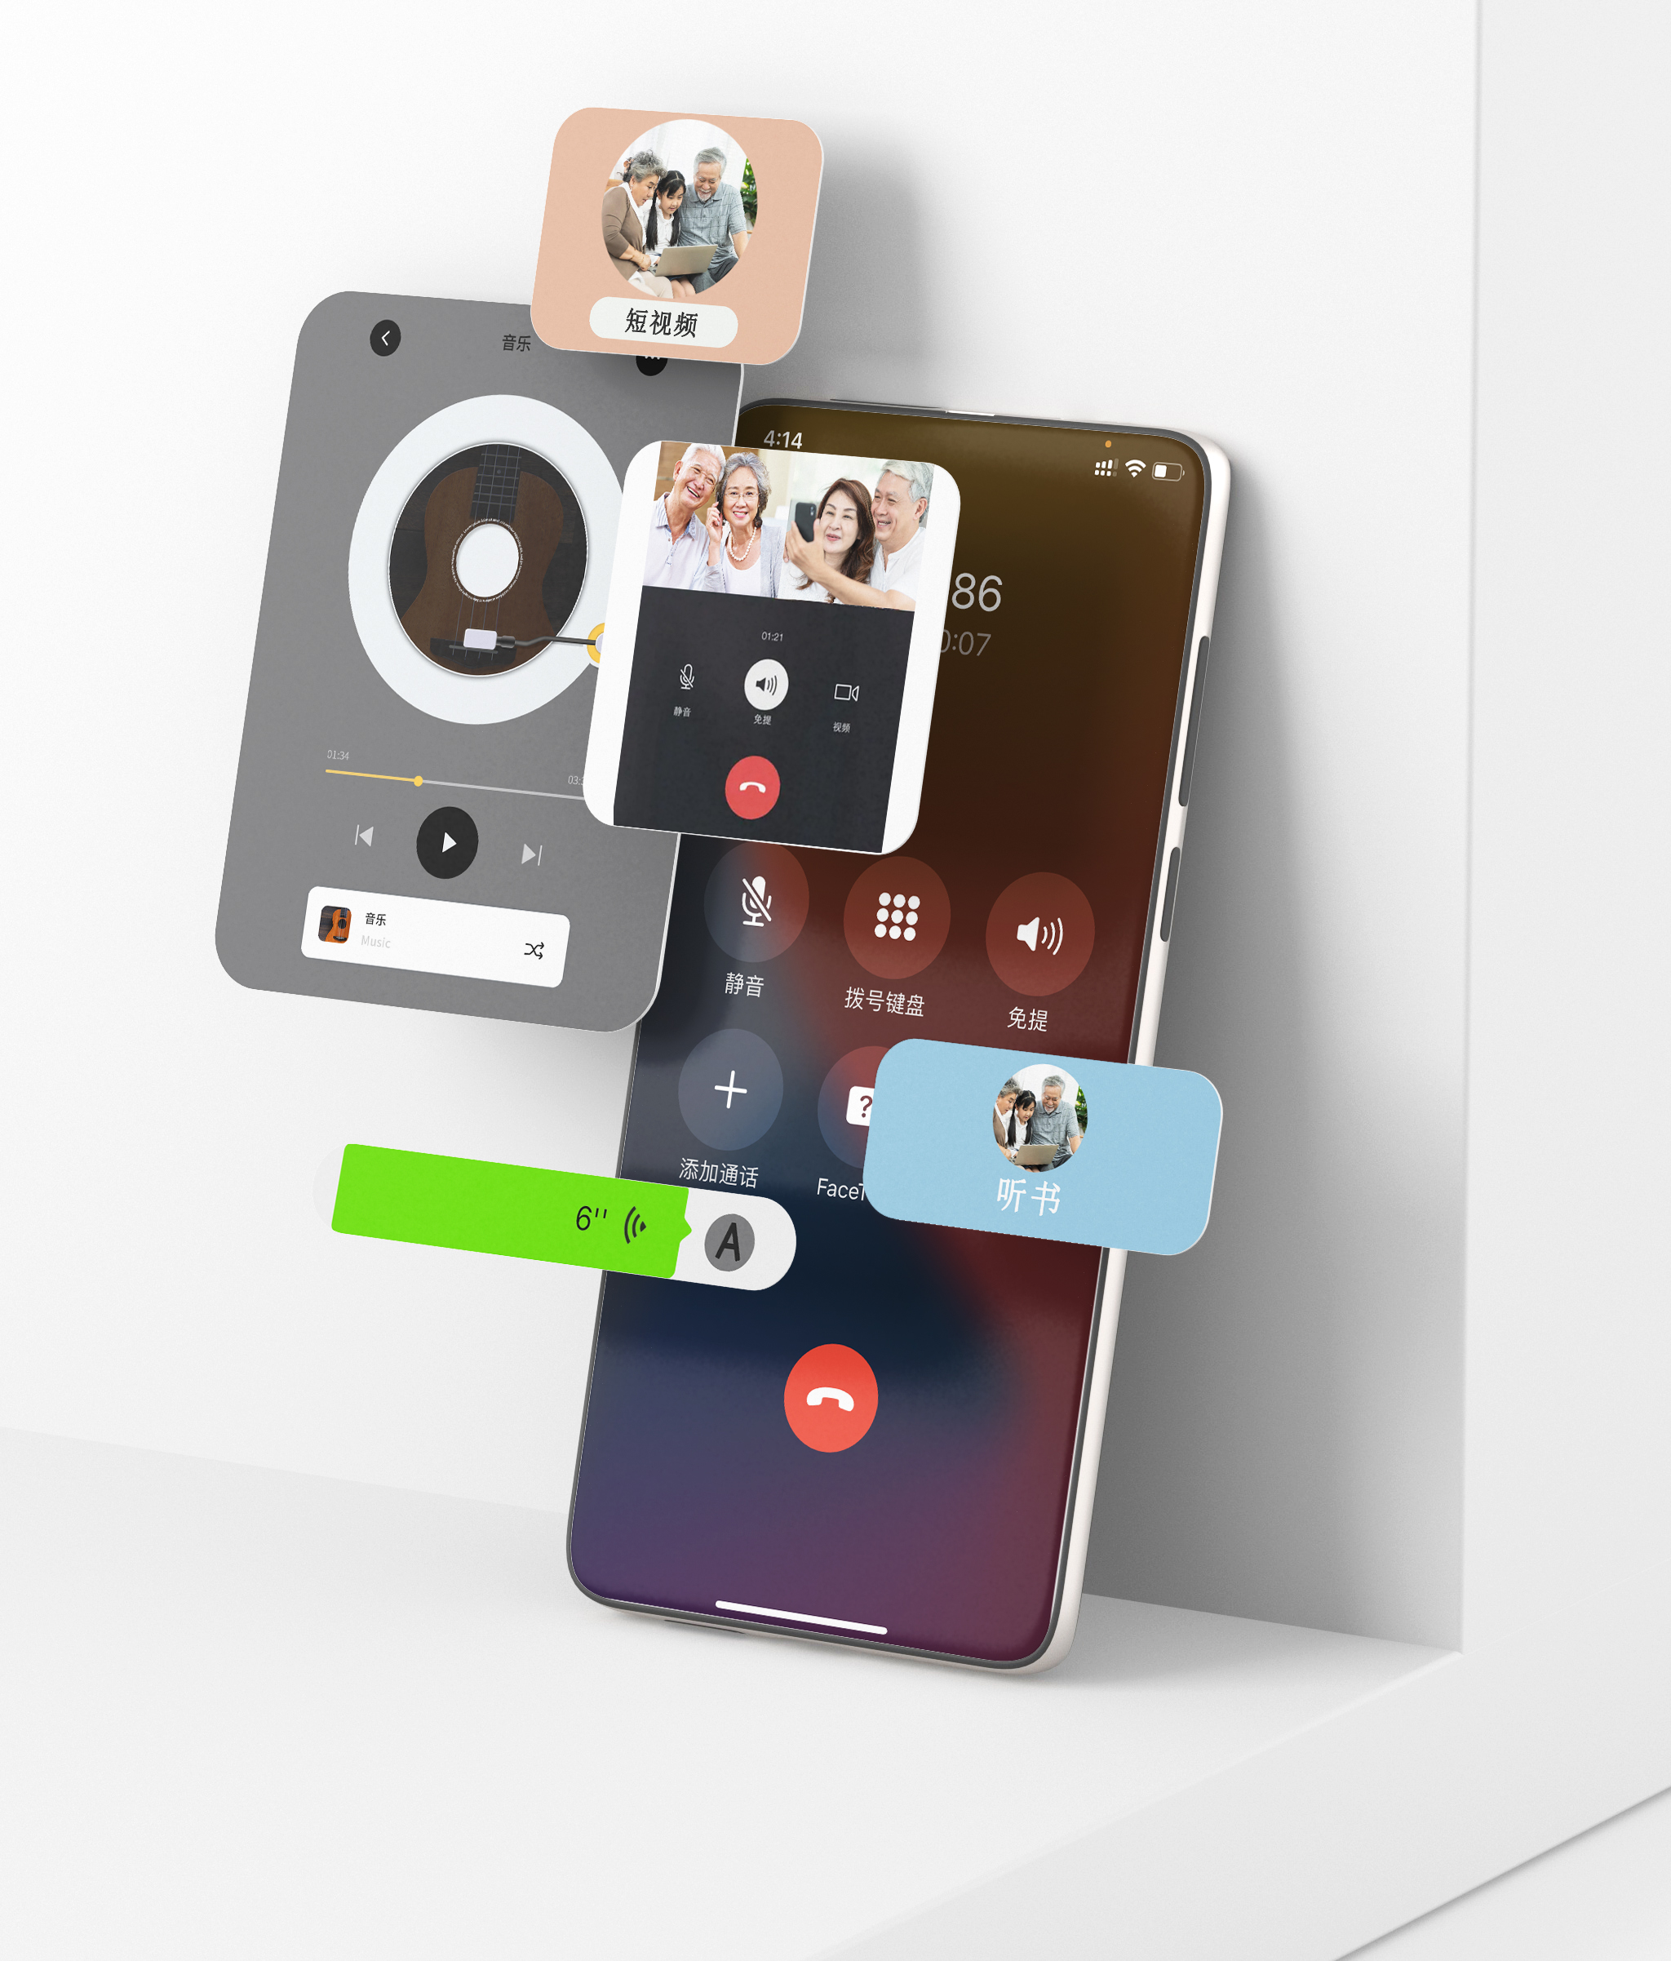
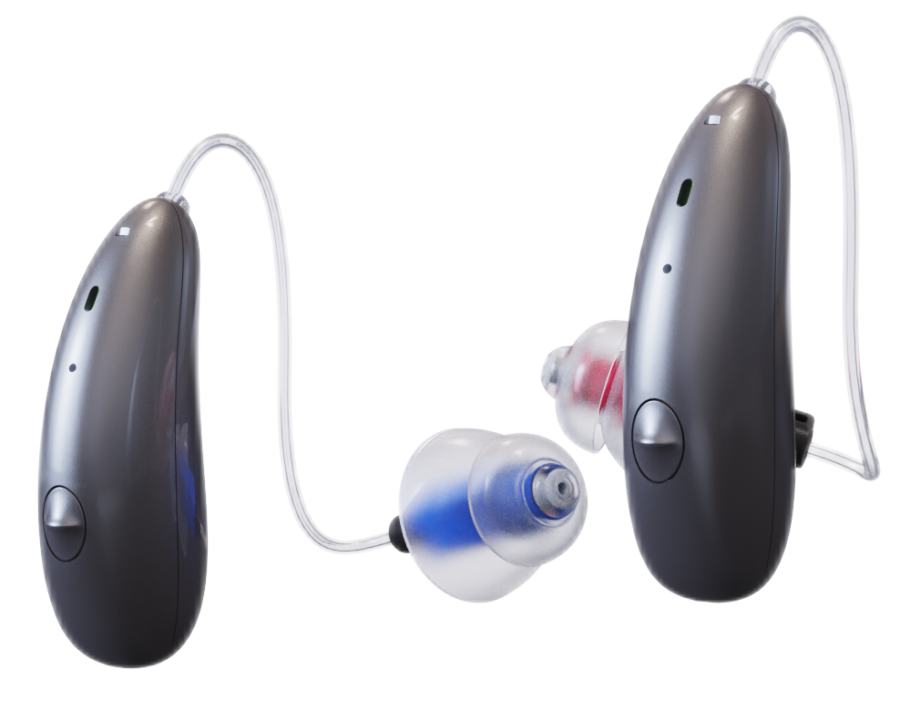
Direct Audio Streaming
The latest Bluetooth technology adds even more features to your hearing aids that allow you to take phone calls, listen to music, videos, or podcasts up to 30 feet away.

Slide 7
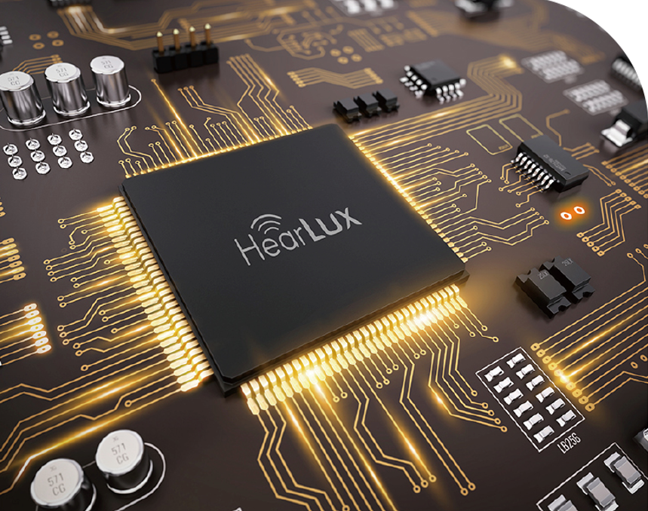
Digital Signal Processing
Enjoy higher definition, sensitivity, and detail in your hearing across the entire frequency range of hearing from our digital signal processing technology.

Slide 8
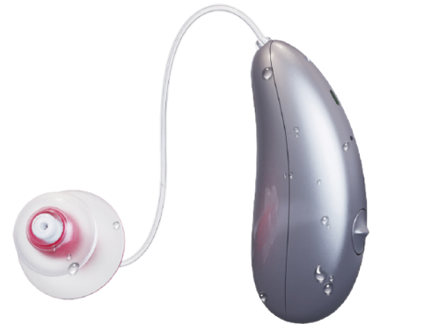
Hear Matter You Like
For a fuller, richer sound and outstanding life quality. We offers wearers four sound profile settings.
To enjoy what’s precious, the special time, the beautiful of the voices.

Slide 9
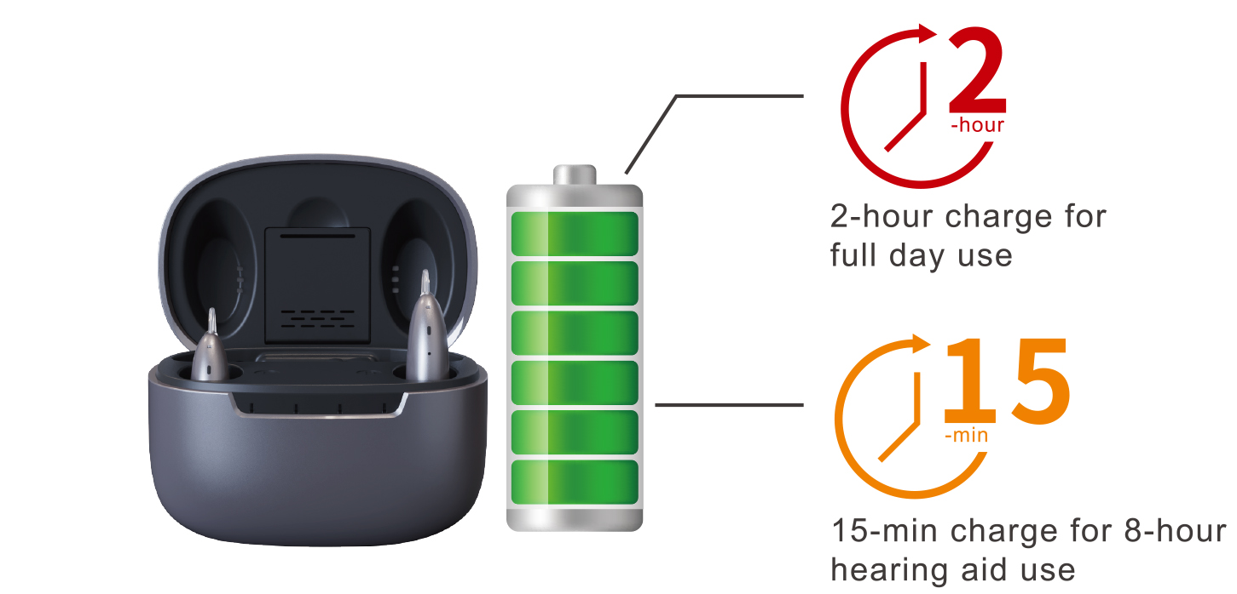
Recharge on-the-go
The DW5A features advanced rechargeable battery technology that powers your aids to deliver
an entire day’s worth of hearing.
And with the powerbank , you
can go a full 72 hours
without having to plug
back in.

Slide 10
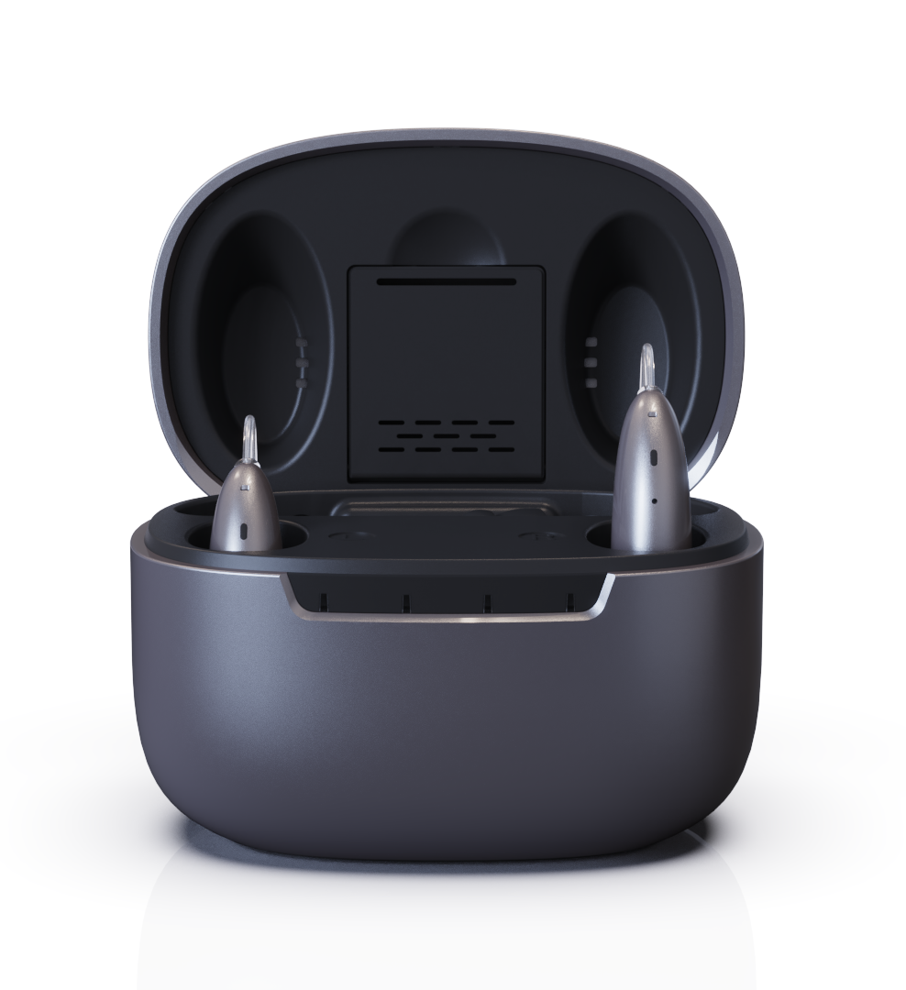
3-in-1 Recharging Base
3-in-1 Multifunction Charging Case a. Power Bank Function i. Provides an additional 3 full charges so that you can be on the go. The added convenience and flexibility make it perfect for short trips.
b. Drying Function i. Removing any moisture in the aids during storage, the multifunction case helps keep your devices in the best condition.
c. UV Sterilization Function i. The case has UV light that can kill up to 95% of the germs that can collect on your hearing aids through daily use.
UVC
Lamp
3 in 1
Charging
Case
Dry
Box
Power
Bank

Slide 11
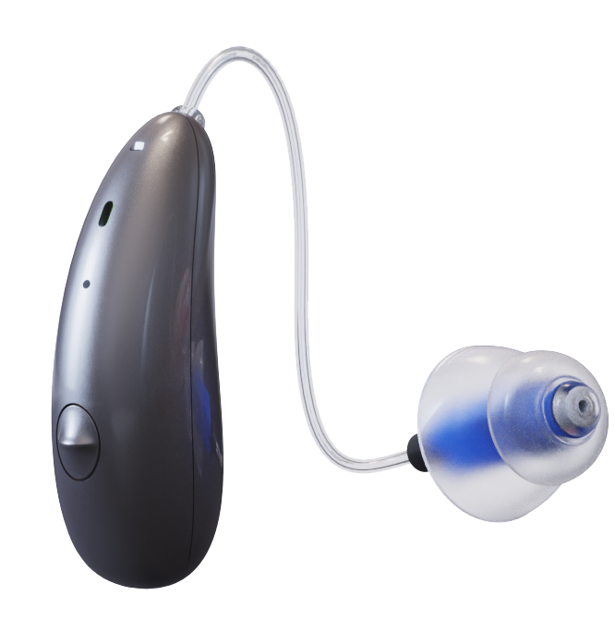
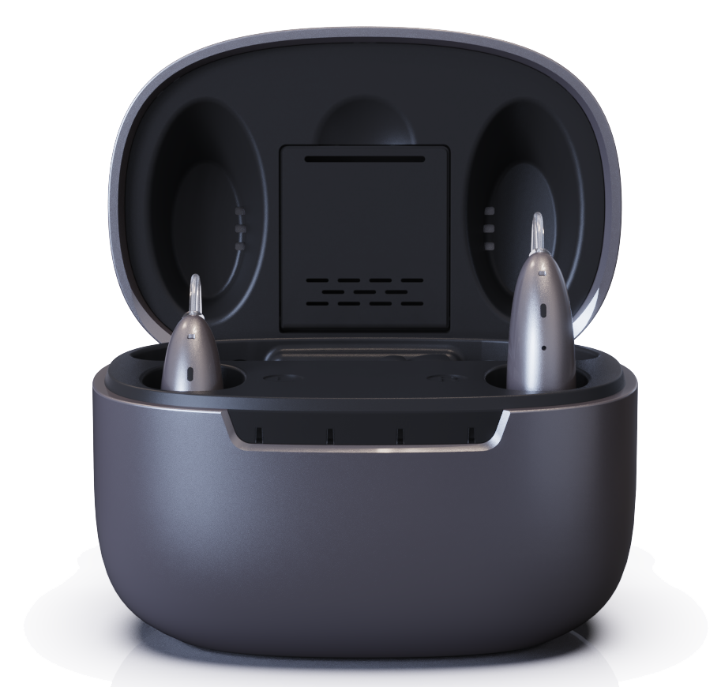
Part of the device
Dimension:
Ear Tube
Microphone
Indicator light
Ear Dome
Multi-function button
(On/Off, Hearing Mode Change)
Space for Drying
(Optional)
Speaker Unit
UV Lamp
Indicator Light
Dimension:

Slide 12
